Slide 1
CloudGuard Agent
This project delivers an AI-powered security remediation pipeline that captures Security Command Center alerts, logs them to BigQuery for compliance auditing, and uses Firestore to seamlessly deduplicate notifications. When a vulnerability is detected, Vertex AI automatically translates the threat into deployable Terraform code and presents it to engineers via an interactive Google Chat alert. By allowing engineers to resolve the issue with one click via an automated GitOps Pull Request, this solution drastically reduces response times while enforcing strict infrastructure-as-code controls.
CloudGuard Agent is an autonomous cloud security assistant that turns Google Cloud Security Command Center (SCC) findings into instant, actionable decisions inside Google Chat. With Gemini analysing the threat, the agent drafts the well-thought suggestions and possible remediations. CloudGuard bridges threat detection and remediation from minutes to a single tap. Whether you need to deploy an automated Terraform fix via GitOps, assign a GitHub issue, or escalate to an owner, CloudGuard lets security and DevOps teams remediate risks in seconds directly from chat.

Slide 2
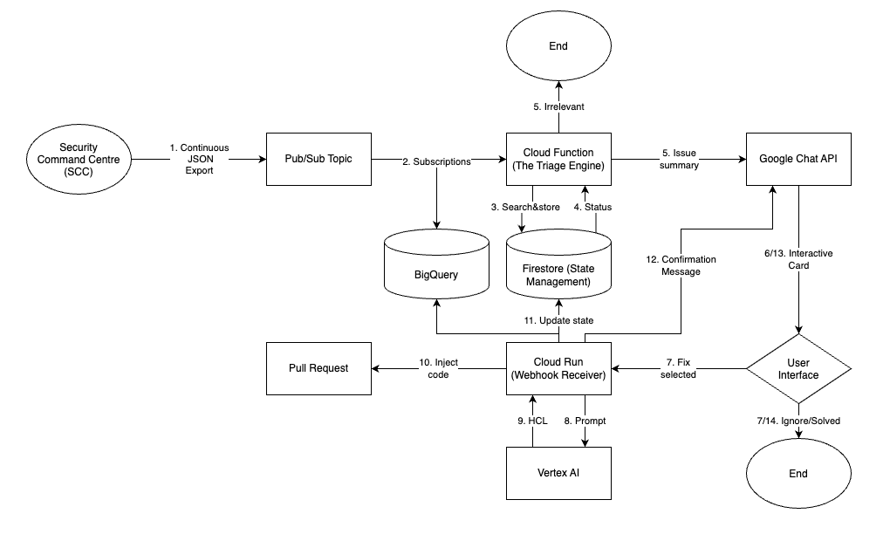
Architecture Diagram

Slide 3
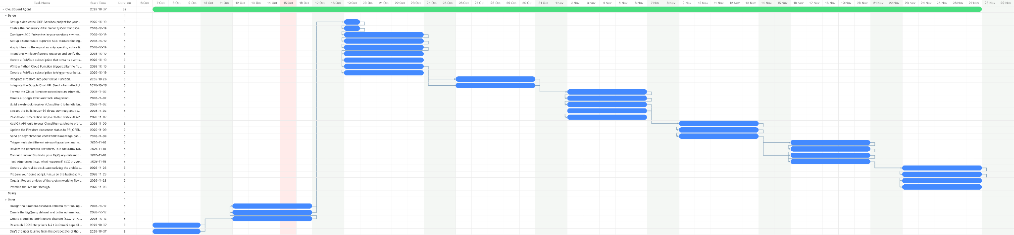
Gantt Chart

Slide 4
Timeline Design
February | March |  |  |  | April
WEEK 1 | WEEK 2 | WEEK 3 | WEEK 4 | WEEK 5 | WEEK 6 | WEEK 7
Understand Stakeholder Landscape, Requirements and Readiness
Assessment of AI Safety Considerations
and Guardrails
AI Briefing Hub Prototypes
Project start
Project
end
Assessment of Prototypes
Assessment of Technology Landscape and Considerations
Final Report
We are here
Notes:
Justin

Slide 5
Firestore Schema (JSON)
{
// Document ID: organizations/123/sources/456/findings/abc
"status": "PR_OPEN",
"resource_name": "//storage.googleapis.com/prod-customer-data",
"category": "PUBLIC_BUCKET_IAM",
"severity": "HIGH",
"created_at": "2026-10-14T15:30:00Z",
"updated_at": "2026-10-15T09:12:00Z",
"chat_message_id": "spaces/AAAABBBCCC/messages/123456",
"handled_by": "anthony.youssef@goreply.com"
}

Slide 6
BigQuery Schema (SQL)
CREATE TABLE `your-project.scc_analytics.alerts_state` (
finding_name STRING NOT NULL OPTIONS(description="The unique SCC finding name (Document ID in Firestore)"),
status STRING NOT NULL OPTIONS(description="Current state: NOTIFIED, ACKNOWLEDGED, PR_OPEN, RESOLVED, IGNORED"),
resource_name STRING OPTIONS(description="The GCP resource affected (e.g., projects/my-proj/buckets/data)"),
category STRING OPTIONS(description="The type of finding (e.g., PUBLIC_BUCKET_IAM)"),
severity STRING OPTIONS(description="CRITICAL, HIGH, MEDIUM, LOW"),
created_at TIMESTAMP OPTIONS(description="When the finding was first ingested"),
updated_at TIMESTAMP OPTIONS(description="When the status was last changed"),
chat_message_id STRING OPTIONS(description="The ID of the Google Chat message"),
handled_by STRING OPTIONS(description="The email of the engineer who took action")
)
PARTITION BY DATE(created_at);

Slide 7
Notes
Vertex AI to clean SCC logs
agent for recursive code corrections
agent with a couple tools
Big query canvas not looker
high level goals (by the end of the week have map/gitops integration) for me
higher level goals for management
ANTIGRAV
is this the right thing
ratelogs for risk
s/w
help with timelines
KNOW WHAT SCC CAN DO
For this week, I want you to set up a folder and drive and put everything you require into it so we can share the details there. Also, research SCC thoroughly on how to start integrating and exporting it, and how that works. Remind me to start building a project on GCP. For yourself, use anti-gravity to create a risk log that simulates the reality of an actual project. Then, create two high-level diagrams: one for the actual presentation, showcasing the high-level stuff like research, and another for the building steps. Finally, create a slightly lower-level diagram for you to do on a daily or weekly basis.

